Slide 1
Amazon Music
Developing the product
Product Owner: Bipin Kumar Sultania
© 2019 Udacity. All rights reserved.

Slide 2
Getting Started

Slide 3
Create Project Blueprint
A product launch is not just about deploying a beautifully designed,built and thoroughly tested feature. Your company needs to be equally prepared if not more to support every possible customer interaction associated with the product (e.g landing on your company website to learn more about the new feature)
© 2019 Udacity. All rights reserved.
Notes:
[ALL PARTICIPATION]

Slide 4
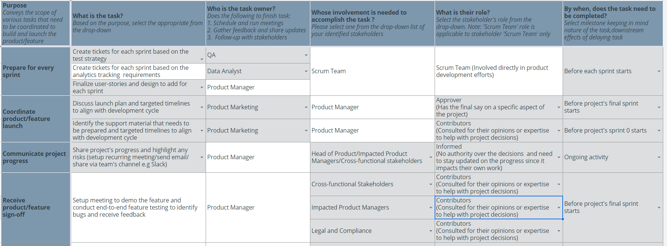
Create a coordination activities map
Share your project-specific coordination activities map here (Insert Link here). You can also share a screenshot below.
SAMPLE
© 2019 Udacity. All rights reserved.

Slide 5
Plan for Sprint Meeting
As a PM, it is important to stay ahead of your scrum team and be prepared for every upcoming sprint by having a target goal defined with prioritized backlog for team to start costing and breaking down the tasks
© 2019 Udacity. All rights reserved.
Notes:
[ALL PARTICIPATION]

Slide 6
Sprint Planning Meeting Preparation
Sprint Goal
A user I should be able to manage playlist along with sharing and searching
Sprint Backlog (list the prioritized user-stories from the product backlog)
1 | As a user, I want to create playlist so that I have all my favorite songs at one place
2 | As a user, I want to edit playlist so that I have update my favorite songs from the list
3 | As a user, I want to delete playlist so that I can delete the existing playlist
4 | As a user, I want to share my playlist to my friends so that my friends can listen to my collections
5 | As a user, I want to search track on my playlist so that I can quickly find the track in the playlist
Sprint Prioritization Logic
Have a fully functional deliverable at the end of this sprint, where the feature can be accessed to start testing from the first sprint onwards Prioritized riskier work that involves API integration ahead since it may require multiple sprints
© 2019 Udacity. All rights reserved.

Slide 7
User Story 1
User Story | As a user, I want to create playlist so that I have all my favorite songs at one place
Design | https://www.figma.com/proto/pMEwn1SkJuhLIFWKbe3rlE/MusicApp-Copy?node-id=1%3A1344&scaling=min-zoom
Acceptance Criteria | The playlist should be arranged in alphabetic order A user can make maximum 100 playlist A user can’t give blank or null name for the playlist A playlist name can have maximum of 32 characters The playlist name should be only in alphanumerical, no special character allowed
Assumptions | Amazon is (ADA compliant) and mobile responsive, engineering team builds all features to be compatible with these requirement Product is available in U.S only and the MVP will be launched in English only
© 2019 Udacity. All rights reserved.

Slide 8
User Story 2
User Story | As a user, I want to edit playlist so that I have update my favorite songs from the list
Design | https://www.figma.com/proto/pMEwn1SkJuhLIFWKbe3rlE/MusicApp-Copy?node-id=1%3A1344&scaling=min-zoom
Acceptance Criteria | A user can edit playlist name Error if user enter special character on playlist name A user can delete tracks from the playlist A user can add more song directly from playlist A playlist name can have maximum of 32 characters
Assumptions | Amazon is (ADA compliant) and mobile responsive, engineering team builds all features to be compatible with these requirement Product is available in U.S only and the MVP will be launched in English only
© 2019 Udacity. All rights reserved.

Slide 9
Decoding API Documentation
As a PM, you will collaborate with the engineering team and provide guidance that heavily influences their development approach. When a product requires an API integration, sometimes PM need to be “technical enough” to understand the following to refine the solution with designer and development team
what information is available via the API
how is it available
possible pricing impact
© 2019 Udacity. All rights reserved.
Notes:
[ALL PARTICIPATION]

Slide 10
Streaming Music Project
Based on the API documentation how would you update your solution and design? | We need to allocate our space in S3 based on the location so that our customer upload are in one place. Also we need to make sure we backup our user data time to time. To successfully upload the file we need to provide unique entity tag to the file, along with other response element for every request of upload user make. Also the Based on the API only need server-side Encryption, we need to provide AWS KMS customer master key.
Based on your high-level understanding of the API documentation, are there any details that you want to discuss with engineering to refine solution and/or determine feasibility | What happen if the user is uploading a file and lost internet connectivity in between? What are supported file format by this API? What happens if the user tries to upload unsupported format file? What if someone upload very big file size like 1-2gb or even more?

Slide 11
Re-prioritize Sprint Backlog
As a PM, unexpected issues and new feature requests will require you to triage them efficiently and re-prioritize the sprint backlog without impacting the roadmap deliverables significantly
© 2019 Udacity. All rights reserved.
Notes:
[ALL PARTICIPATION]

Slide 12
Issue 1: Landing Page loading too slow
Determine impact and criticality to prioritize issue | It is very frustrating for users when the landing page is too slow. Data show if the landing page doesn’t load in 3 seconds, 40% of the users abandon a website. Also 1 second delay in page response can result in a 7% reduction in conversions. Effort required for the fix is high. Depending on my earlier loading time I would give the priority as critical or high. Suppose my loading time was less than 1sec, then 38% slower won’t affect much however if my loading time was more than 2 seconds earlier than I would prioritize is as critical.
Next Steps You would carry out typically using JIRA (ticketing tool), communication channel (Slack) | Notify impacted stakeholders of issue impact and root cause, timelne to fix the isue using ticketing tool and email. I would setup meeting with QA and find out absolute time it is taking to load the page before and after. Update issue priority to high if the load time is still under 2sec or so. Create a subtask under backlog of the user story. Utilize Customer and stakeholders request buffer in sprint backlog Follow up when the fix for the issue is deplyoed, share plan to avoid furure occurences.
Would you take additional steps ? | I would ask QA to run the speed test everytime before a new feature is introduce so that proper measure can be taken. Aslo ask Analytics team to closely monitor whats are the issue which is causing the landing page to slow down, it is the server load, or to many request or something else.
© 2019 Udacity. All rights reserved.

Slide 13
Issue 2: Misaligned fields in Profile Settings
Determine impact and criticality to prioritize issue | Since the user accessing the page with misalignment is only 2% that too in android app I would change the priority to Low. The effort required to fix it should be low. Issue can be fixed much later since delaying the fix doesn’t cause significant impact. It is just misaligned and not breaking any functionality nor affecting the speed so it is something which can be pushed to next sprint.
Next Steps use ticketing tool (JIRA), and communication channel (Slack) | Would repriortize the ticket to Normal Communicate with developers, if they have any bandwidth to take this up. If not push it to next sprint. Take it at the end of this sprint after the new feature development and important issue has been fixed
© 2019 Udacity. All rights reserved.

Slide 14
Respond to Customer Service Manager’s Email
Determine impact and criticality to prioritize the issue (1 - Critical; 2 - High; 3 - Normal; 4 - Low) | This would have a negative impact caused by a combination of percentages of users affected when this feature is not working and lack of work around for the user to be able to reset their password and log into their mobile app. Since 7% of the daily users are affected it will lead to high number of user's fallout. This issue affects a critical part of the product making it unusable and user can’t proceed. This is issue Prioriity 1, it must be resolved ASAP due to severe impact on the user.
Next Steps You would carry out typically using JIRA (ticketing tool), communication channel (Slack) | Notify impacted stakeholders of issue impact and root cause, timelne to fix the isue using ticketing tool and email. Create a critical priority critical issue user task Buffer in sprint backlog to deploy a HotFix. Follow up when the fix for the issue is deplyoed, share plan to avoid furure occurences.
Sample Email Response | I know this has been a very frustrating and trying time for you, and for that I apologize. Please know that our team has been working through the night to resolve these incidents. This has been a tough time knowing that you have to face so many customers calls and emails. I wish I could tell you this issue was unpredictable, or it was all an external party's fault, but it wasn’t. I’m talking with my team about exploring this issue more now. I just want to let you know that this issue is very critical to us, and we’ll get back to you ASAP with proper insight and solutions.
© 2019 Udacity. All rights reserved.

Slide 15
Handle Potentially Difficult Situations
As a PM, you will be faced with many unexpected situations where you have to make a decision or push back while managing competing priorities from stakeholders and tackling issues that could potentially affect your product launch
© 2019 Udacity. All rights reserved.
Notes:
[ALL PARTICIPATION]

Slide 16
Respond to CEO or GM’s request via email
Assessment and result | Check with my team the current status of the product, number of issue and stability. Create account for demo which can be shared with the stakeholders Create mock data which can be showed on the demo Check major workflow are working properly.
Sample Email Response | I am very pleased to accept your invitation to show the demo of the product. We are excited to show you the demo of the product, we are very confident that you would love the product we have been working so hard. However I wanted to inform that since we are still working on the product development and some testing must be done so some functionality might not work as expected. We are trying to resolve as many issues as possible before the demo. Looking forward for the demo and your feedback.
© 2019 Udacity. All rights reserved.

Slide 17
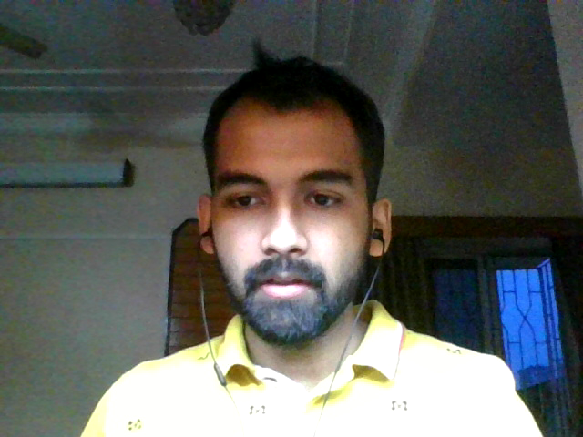
Step-in and guide the scrum team at stand up
Video Response
© 2019 Udacity. All rights reserved.
Notes:
Video Response
Thank you for your update dave.
Please pickup the ticket covering analytics reqirements, ir is currently ‘must-have’ for the launch and is expected to be completed in this sprint. We won't be able to complete it by the end of this sprint if it is not picked up for development by the end of today. The ticket has 5 tracking requirements as of now and I am okay to downgraded 2 out of these 5 to ‘nice-to-have’ if needed to de-risk for the launch.
Next is Jerry please tell us what you did yesterday? What you plan to do today? Is there any blocker.
Thanks for your update, Please complete the code review which is pending from 2 last days. These tickets are blocking two front-end tickets which are in ‘Ready to Test’ status’ from being verified by QA John. Do you want any assist from someone if you busy?

Slide 18
Handling Resource Constraints
List 2- 3 activities that you would carry out as a PM to unblock the scrum team immediately ? | I would re-estimate the size or difficulty of each pending task using "points". Points are a relative measure: tasks with a high number of points should require high amount of work. Also I will measure the effort and impact for all the feature across teams. I will try to negotiate with the head of QA with the data if he can give us any resources.
Since the QA team member is shared across multiple projects, how would you coordinate with other PMs to de-risk your project and raise appropriate visibility ? | I would meet them in person and try to understand why is their project important, what is blocking them and how we can speedup the process. I would then tell the importance of my product and how it might inpact the users and the company goal. I would also
Since there is a potential risk, it is important to raise visibility amongst appropriate stakeholders | Customer Service – As they must be aware of the issue if it is not resolved Engineering includes QA – they are the on who would solve the potential risk Marketing includes Product Marketing – They need to know the potential risk before launch. Without there contribution it would be difficult to launch/ Impacted Product Management
 | If successful in negotiation, then I would tell them impacted PM why I was important. If not successfully than would try to negotiate with the Marketing team to see what can be done.
© 2019 Udacity. All rights reserved.

Slide 19
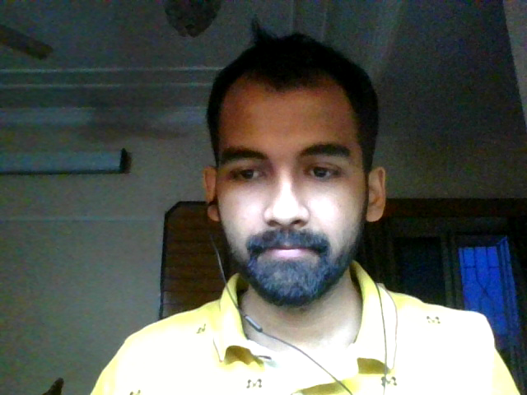
How would you handle stakeholder feedback?
Feedback Assessment | What problems do you see the notification would be solving? What is the evidence of the problems? What do you think could go wrong if we don’t add this feature? In what ways will this feature be a solution to the user problem of streaming?
Video Response
© 2019 Udacity. All rights reserved.
Notes:
I understand your conern here, however Notification feature was not in the scope of Minimal Viable product for launch. Our customer are music lovers who are self motivated to listen to song on regular basis. As we grow we would be targeting more segments. Our goal is to understand the user-journey within the product better after the launch to define the trigger and other details to introduce this feature later on. I would suggest to launch the app without this feature, as it is not something which will block the user from using the app though with the introduction of notification we might find out that user is spending more time on the app however the main focus as of now is to atract user to our app rather a user spending more time on it.

